Slide 1
A quick run through of 180 years of Classical Mechanics – for better appreciation of Quantum Mechanics
The following pages contain the animations that go with the discussion on Newtonian, Lagrangian, and Hamiltonian mechanics. Click on the bar below each figure for the animation.

Slide 2
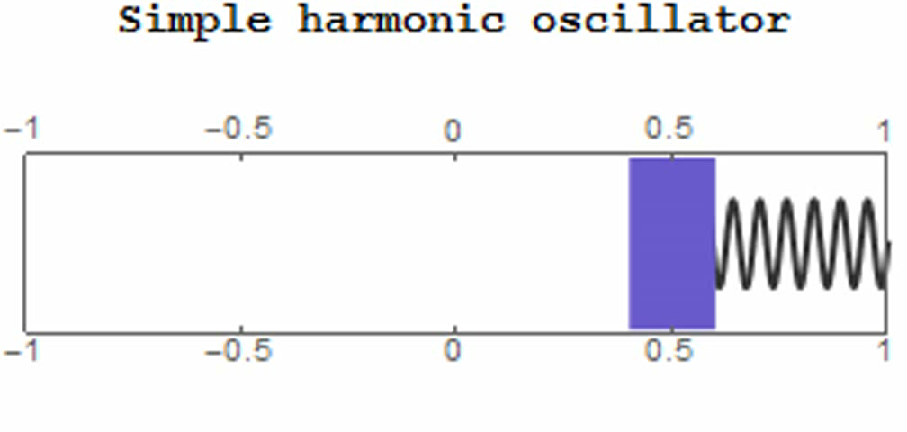
Amplitude:
A = 0.5
Spring constant:
k = 1
Mass:
m = 2
mass m
spring constant k
smooth floor
No air drag…
Template: "Simple Harmonic Motion of a Spring“
from the Wolfram Demonstrations Project
http://demonstrations.wolfram.com/SimpleHarmonicMotionOfASpring/
Contributed by: Kenny F. Stephens II
Same acknowledgment to other animations, unless stated otherwise

Slide 3
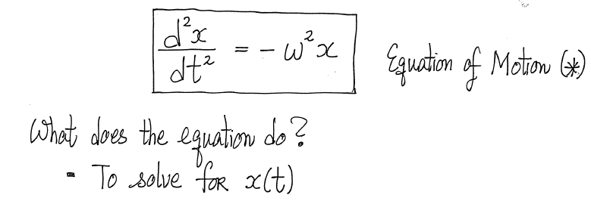
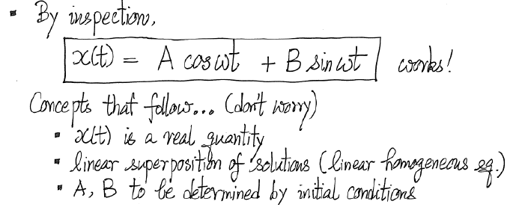

Slide 4
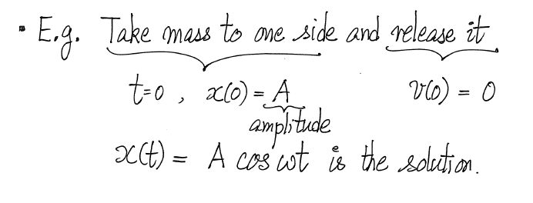

Amplitude:
A = 0.5
Spring constant:
k = 1
Mass:
m = 2
Motion:
x$\left(t\right)= A\cos\left(\sqrt{\frac{k}{m}}t\right)$
This is important! At this point, we could build a clock to measure time. Indeed, Hooke invented a watch. Huygens, Hooke’s contemporary, also invented one. And they fought over priority!

Slide 5
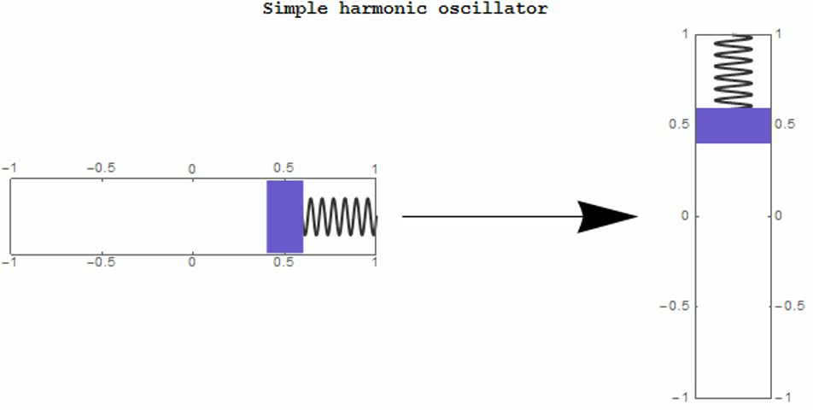
For convenience, sometimes the oscillation is displayed vertically instead without worrying about “g”

Slide 6
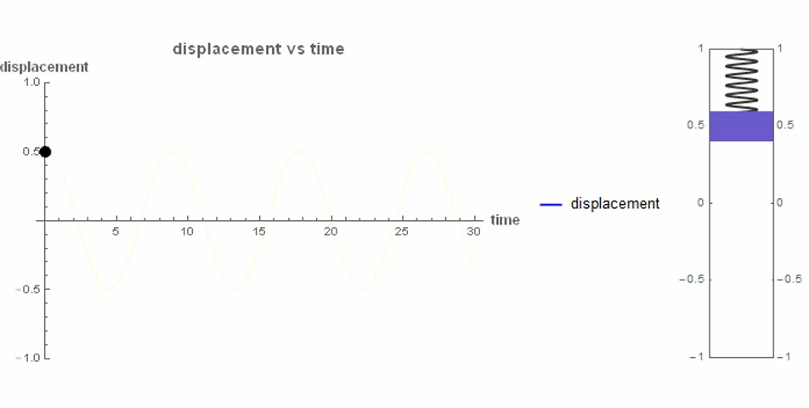

Displacement vs time
Amplitude:
A = 0.5
Spring constant:
k = 1
Mass:
m = 2
Motion:
x$\left(t\right)= A\cos\left(\sqrt{\frac{k}{m}}t\right)$
How about v(t)?

Slide 7
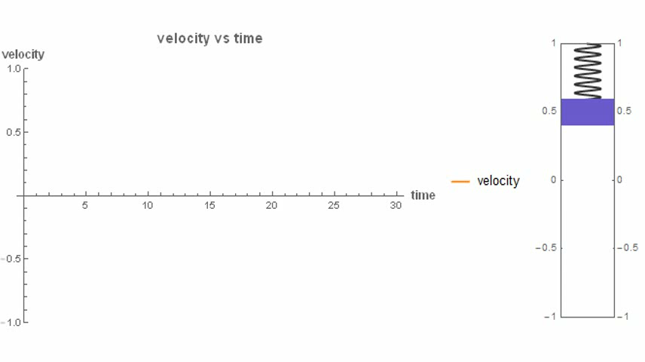
Harmonic oscillator (velocity vs time)
[Animation credit: LEUNG Chun Hei (MPhil Student, CUHK)]

Slide 8
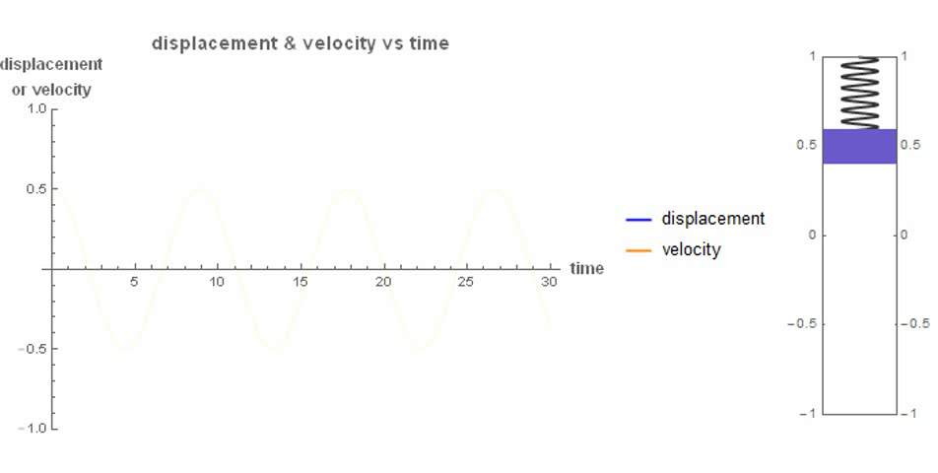
Harmonic oscillator (displacement & velocity vs time)
Work-Energy Theorem
Inspect:
Ranges of time when mass movement and F(x) are in the same direction => speeding up of the mass
Ranges of time when mass movement and F(x) are in opposite directions => slowing down the mass
Question: Any general statement?

Slide 9
The big picture –
For a type of force F(x) (typically depending only on position), work done can be expressed in terms of difference of potential energies
Mathematically, F(x) = - dV/dx and thus defines V(x)
Work-energy theorem then gives the law of conservation of (mechanical) energy
Often provides a convenient way to solve problems, other than solving the equation of motion (following motion in time)

Slide 10
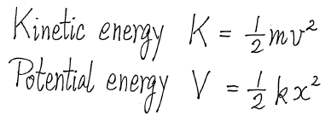
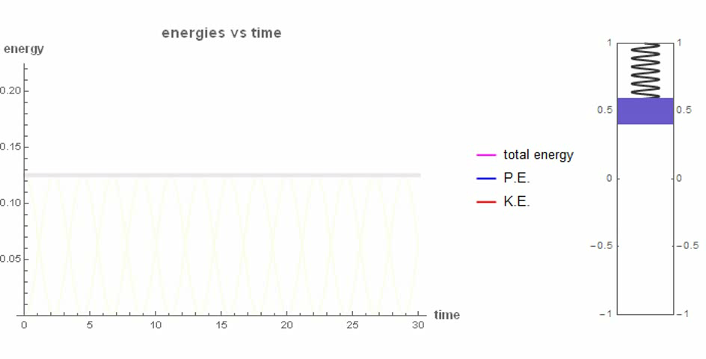


Back to Harmonic Oscillator as example
(PE & KE & E vs time)
Total Energy E = K + V
$Max. = \frac{1}{2}kA^{2}=0.125$
Amplitude:
A = 0.5
Spring constant:
k = 1
Mass:
m = 2
Motion:
x$\left(t\right)= A\cos\left(\sqrt{\frac{k}{m}}t\right)$
[Animation credit: LEUNG Chun Hei (MPhil Student, CUHK)]

Slide 11

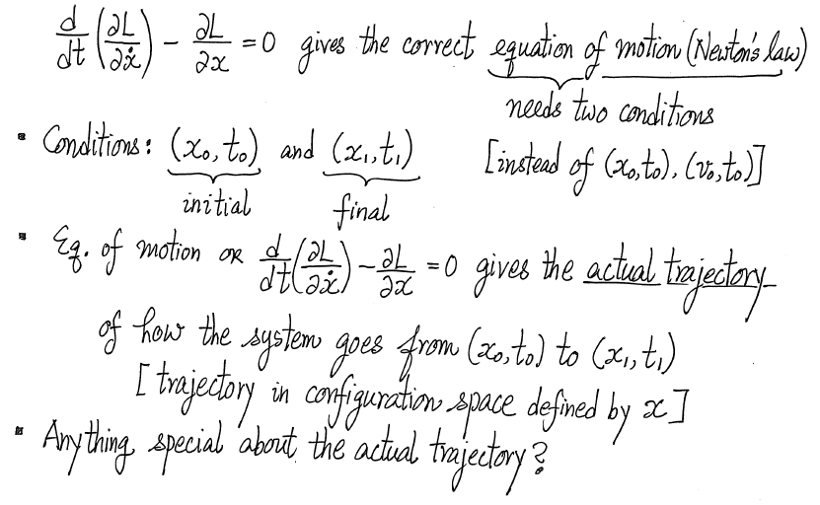
Good Stuff #4:
Principle of Least Action (Hamilton)
A way to interpret the Lagrange equation
(This is the question)

Slide 12
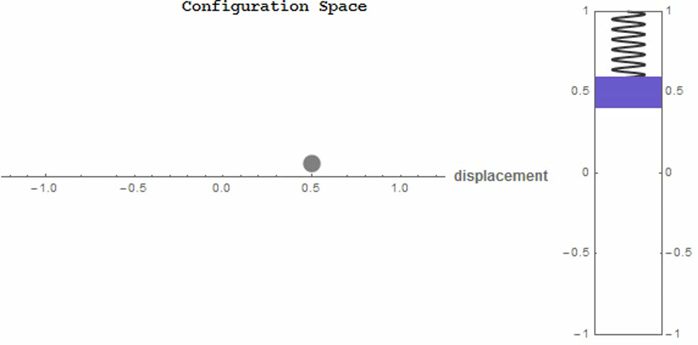
Harmonic oscillator (Configuration Space, displayed horizontally)
Lagrangian Mechanics is about the configuration space, which is just x (a line for 1D problem). The Euler-Lagrange equation (equation of motion) governs how the system evolves in configuration space in time, thus just x(t).

Slide 13
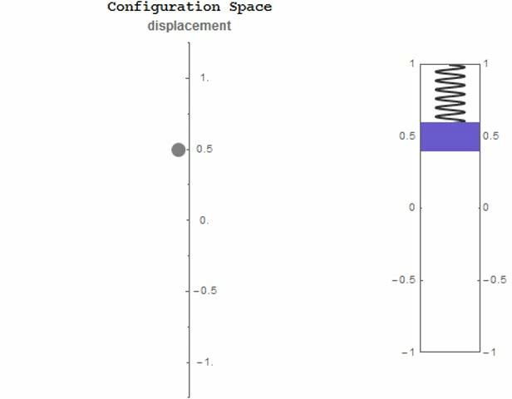
Harmonic oscillator (Configuration Space, displayed vertically)
Lagrangian mechanics is about the configuration space, which is just x (a line for 1D problem). The Euler-Lagrange equation (equation of motion) gives how the system evolves in configuration space in time, thus just x(t), here displayed vertically.

Slide 14
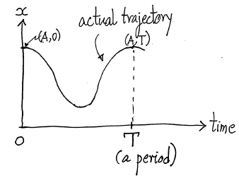
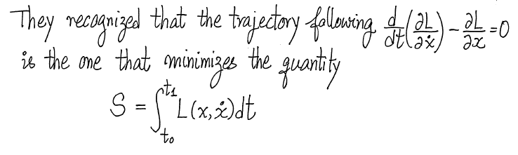
What is so special about the actual trajectory?
[Maupertuis (1747), d’Alembert (1743), Euler and Lagrange (1750’s), Hamilton (1834)]
(The Least Action Principle)
Why taken so long (90 years)? Need to wait for the maths (calculus of variation)

Slide 15
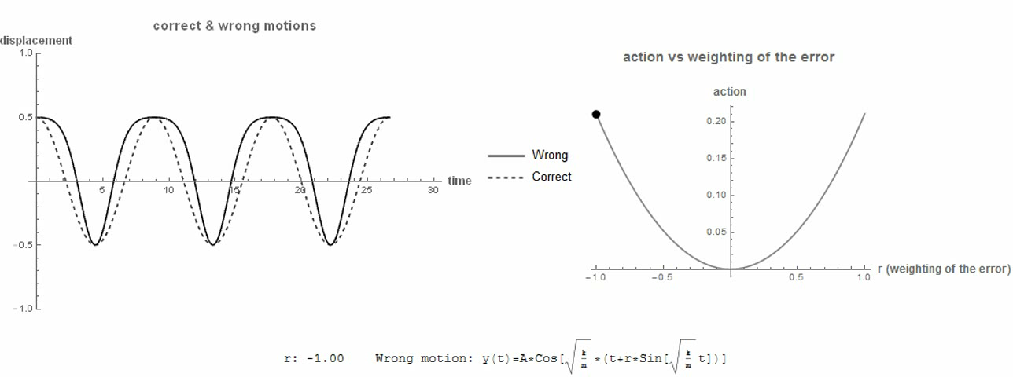
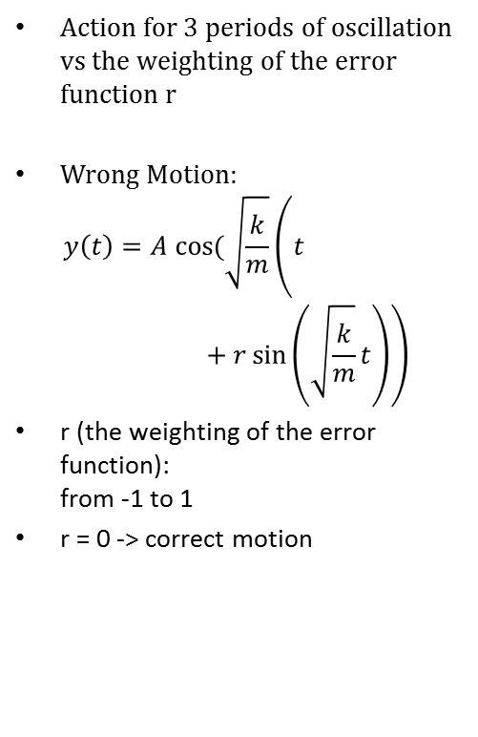
An illustration: Harmonic oscillator (actions for correct & wrong motions)
[Meaning of Least Action Principle: If not following the right trajectory, Action will be higher]
Action for 3 periods of oscillation vs the weighting of the error function r
Wrong Motion:
$y\left(t\right)=A cos⁡(\sqrt{\frac{k}{m}}\left(t+r\sin\left(\sqrt{\frac{k}{m}}t\right)\right)$
r (the weighting of the error function):
from -1 to 1
r = 0 -> correct motion
Dashed line = actual path
[Animation credit: LEUNG Chun Hei (MPhil Student, CUHK)]

Slide 16
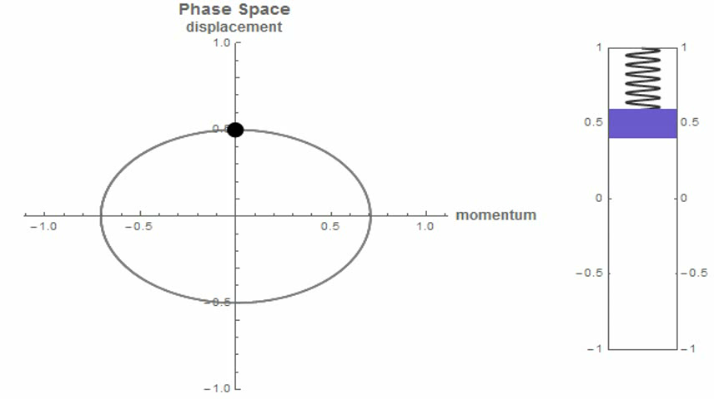
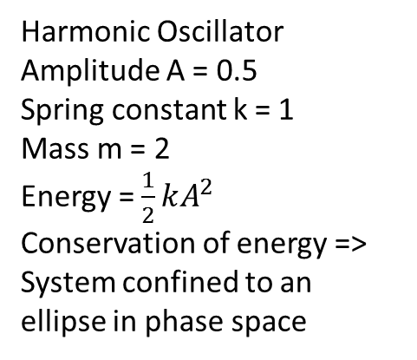
Why is it important?
Go back to Hamilton’s time
H(x,p) describes a system by its coordinate and momentum as it evolves in time
Hamiltonian Mechanics introduces the Phase Space (x,p) (2D phase space) for a particle moving in 1D (x-direction)
Harmonic Oscillator
Amplitude A = 0.5
Spring constant k = 1
Mass m = 2
Energy = $\frac{1}{2}kA^{2}$
Conservation of energy => System confined to an ellipse in phase space
[Credit: LEUNG Chun Hei (MPhil student, CUHK)]

